Slide 1

TROJAN HEX
THERE’S ALWAYS A WAY TO DO IT BETTER
BLOCKCHAIN

Slide 2
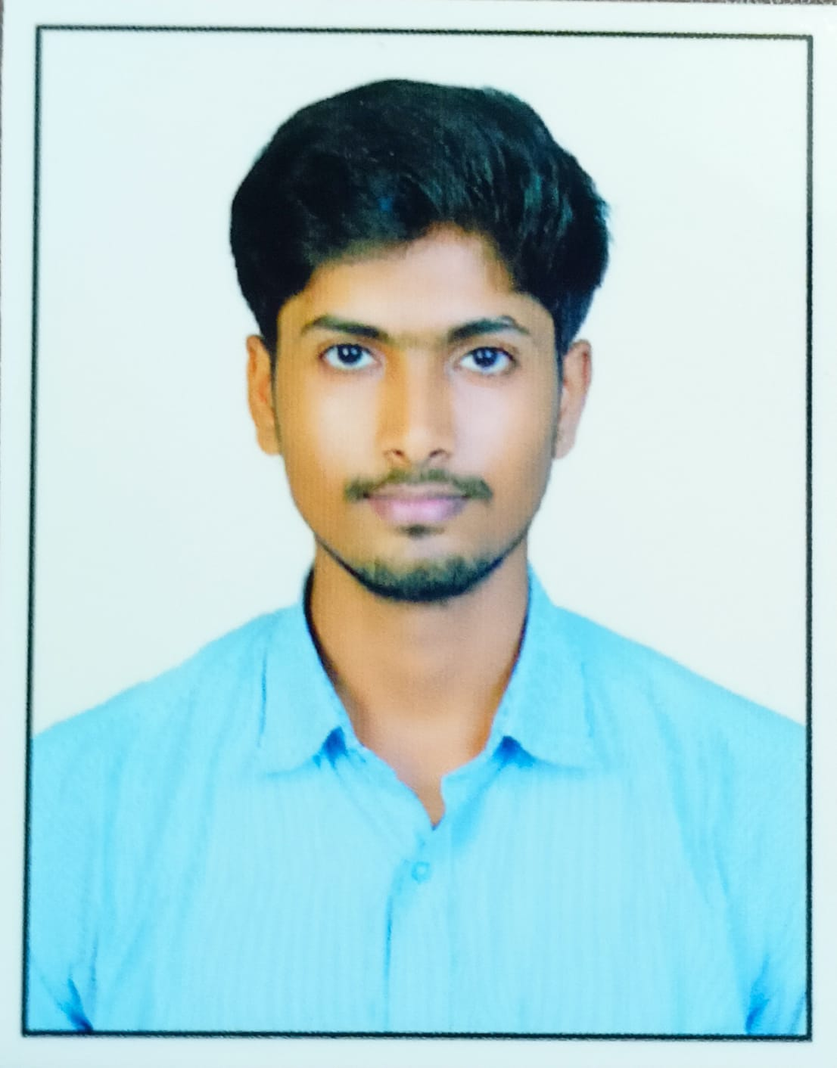


Sandesh Reddy
Girish kshatriya
Dinesh Das

Slide 3
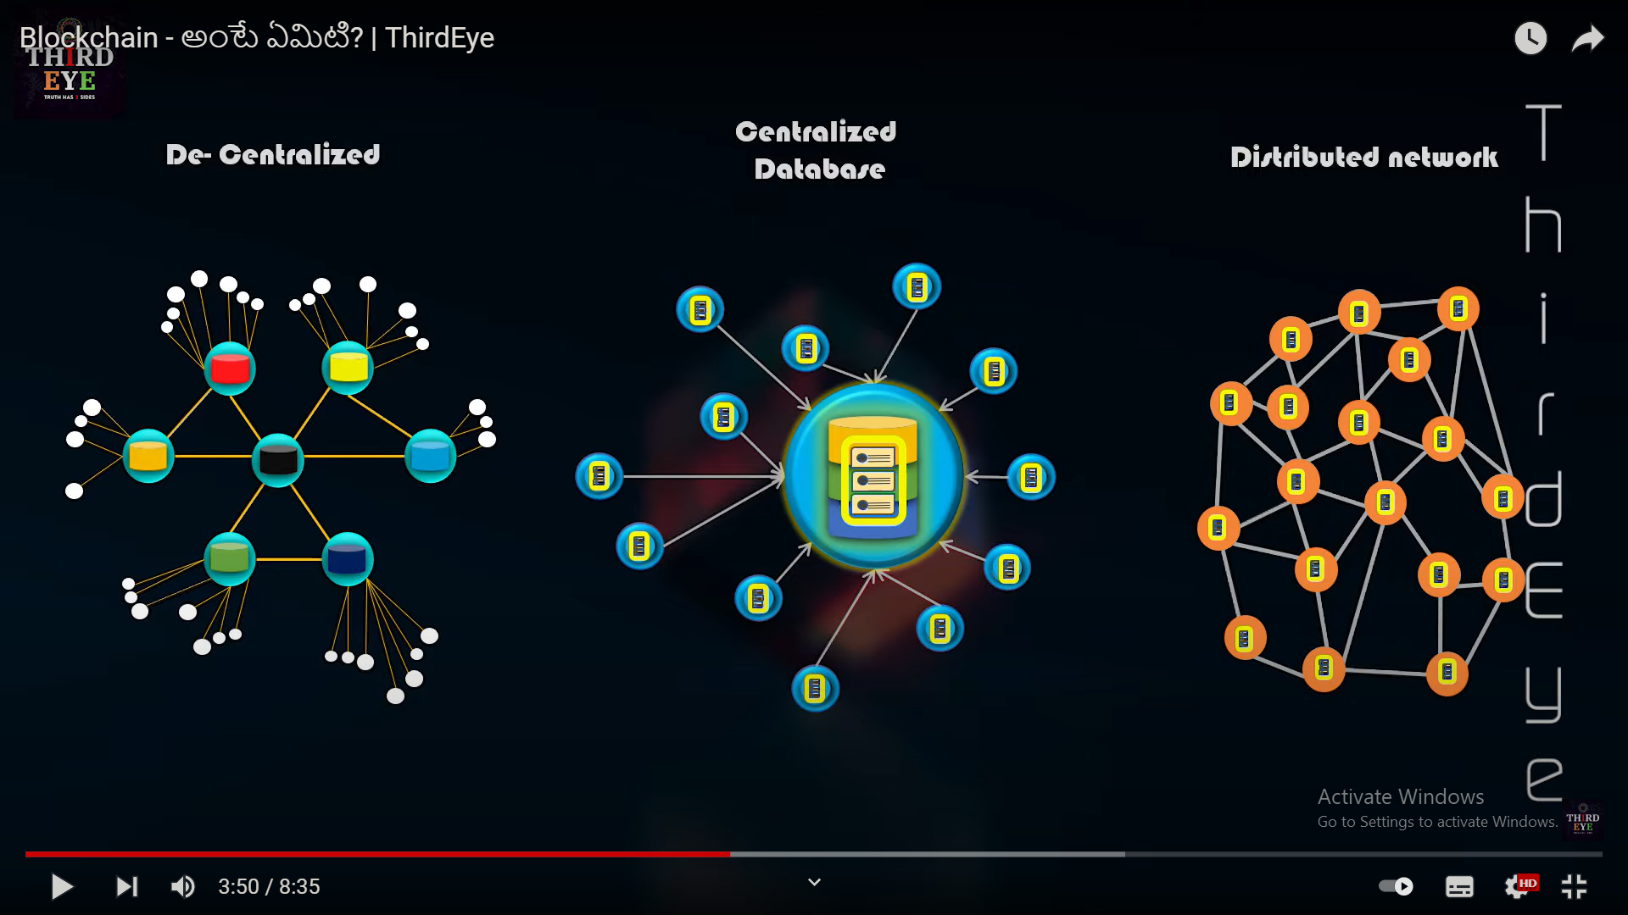

Slide 4



-----------------------------------------------------------------------------------------------------------------------------------------------------------------------------
1.
2.
Hi Ram I need 10 lakh
rupees.
Sure Sam I’m always here
to help you.
Take this cheque
Ram Take this 10,000 that
you have given me
But Sam I have given
you 10 lakh
Ram believed that by giving his cheque there would
be transaction proof. But things are not same every time.
---------------------------------------------------------------------------------------------------------------------------------------------------------------------------
Now both Ram and Sam goes to court for justice

Slide 5




3.
Ram gave you 1 lakh
How did he know
Even after
manipulating the
data
BANK LEDGER
Oops.. I never knew about this
Technology..
Controller of bank ledger

Slide 6
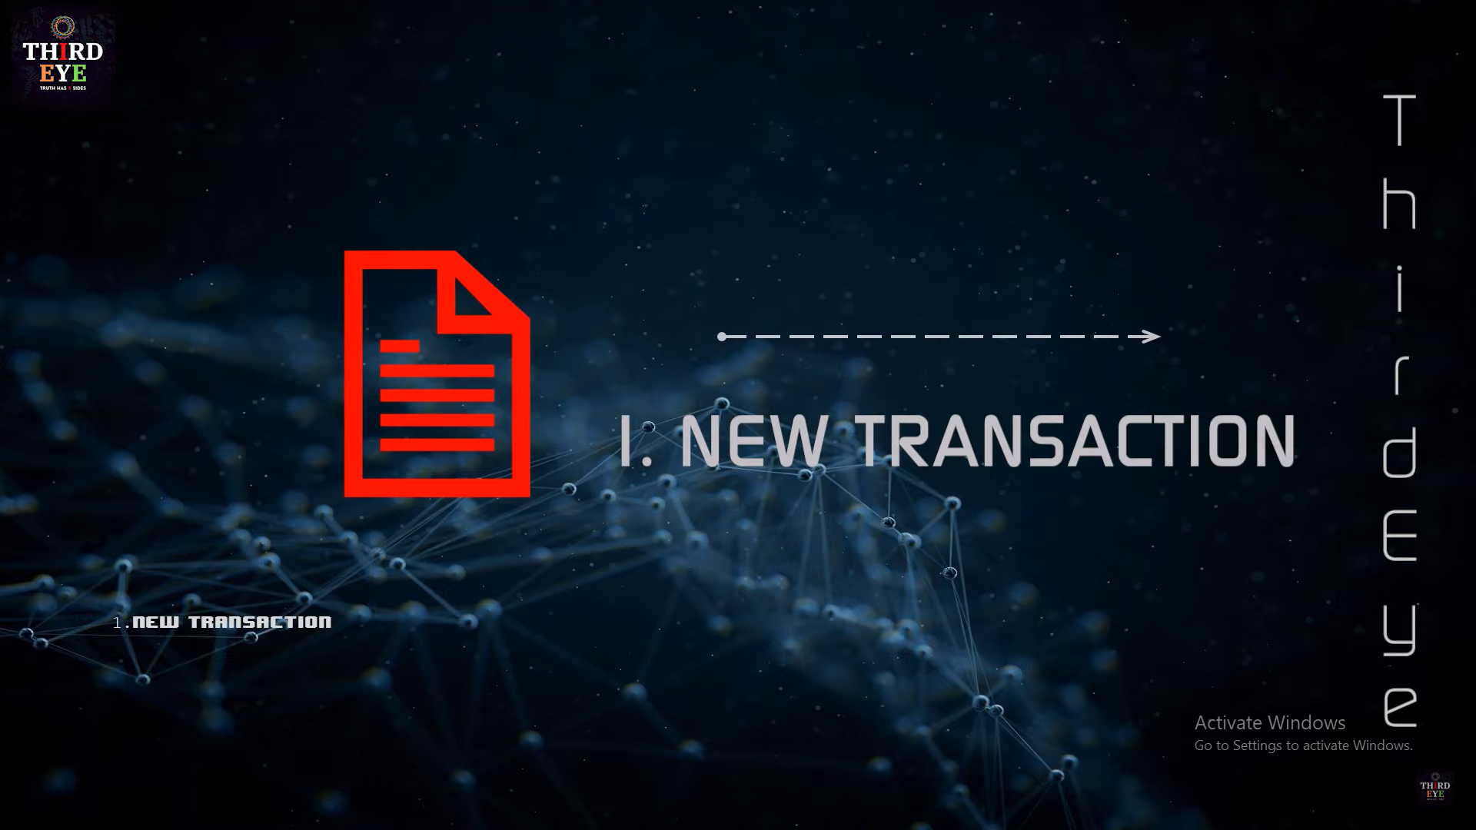
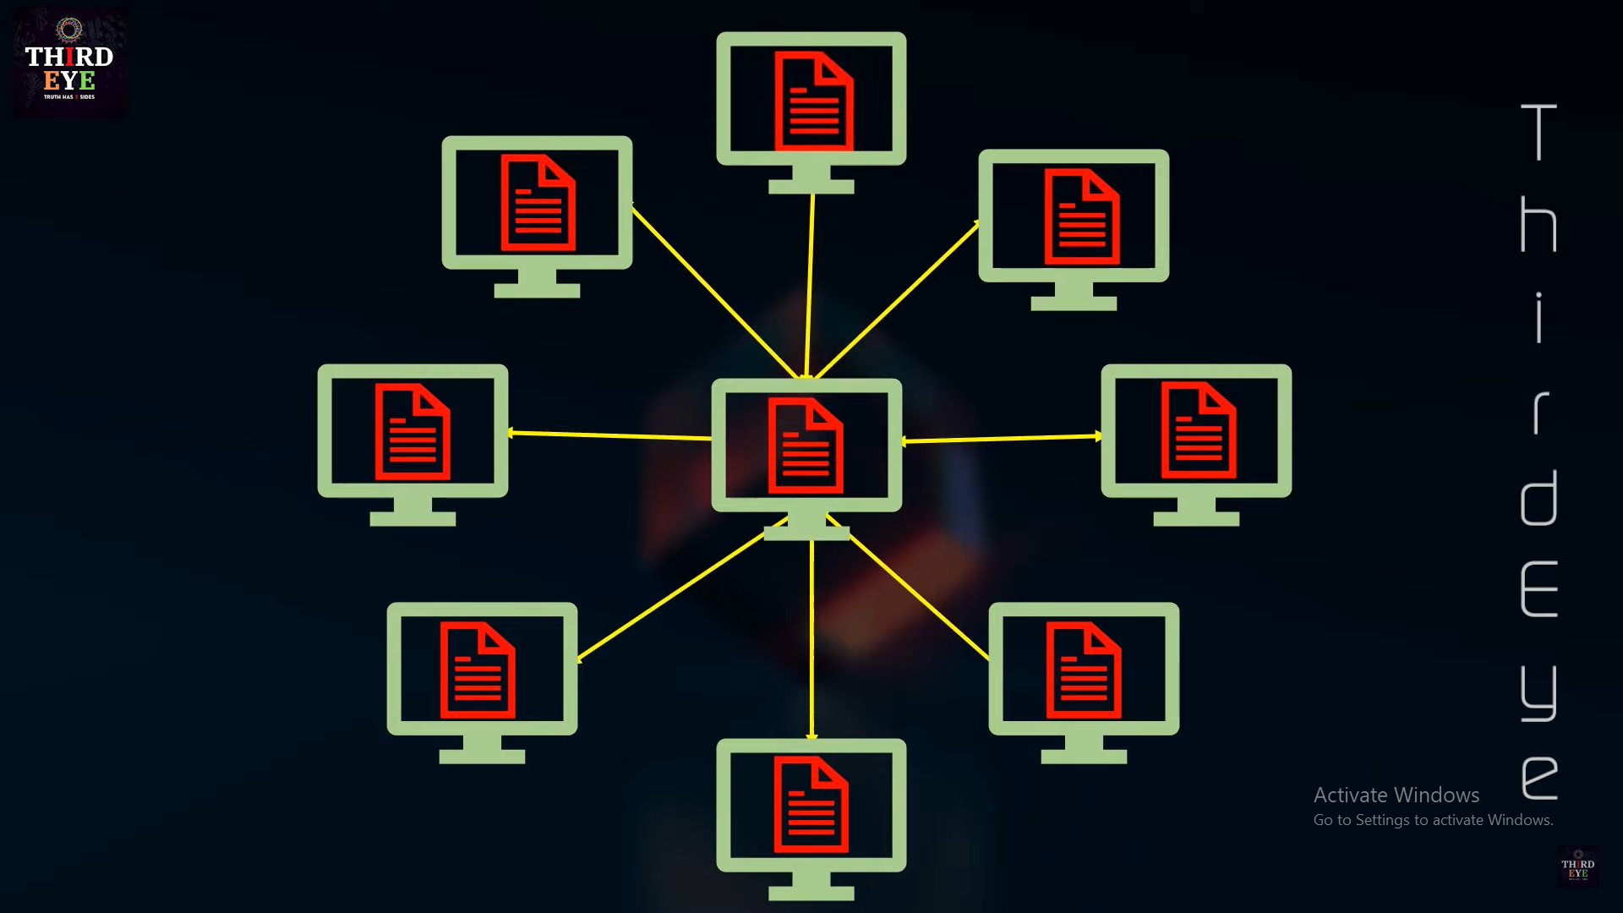
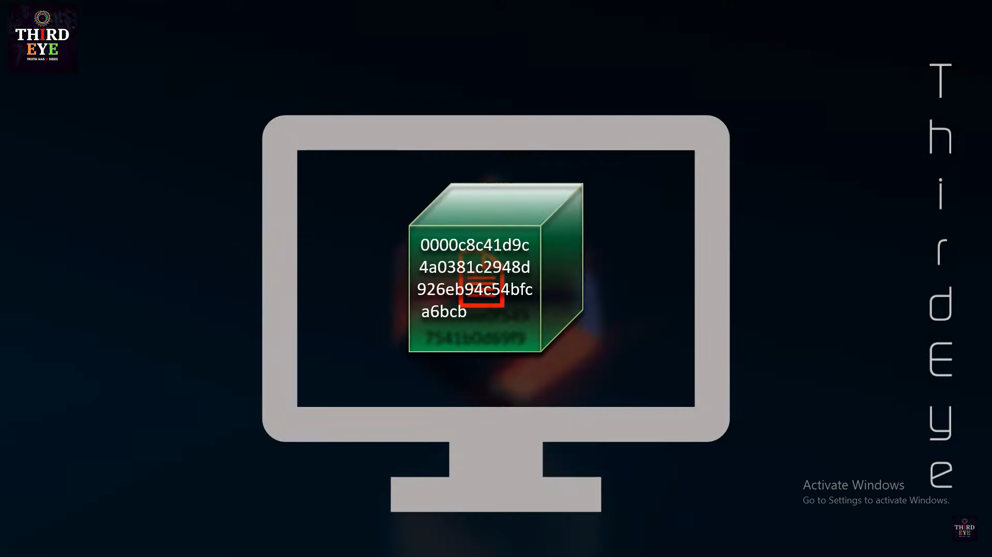
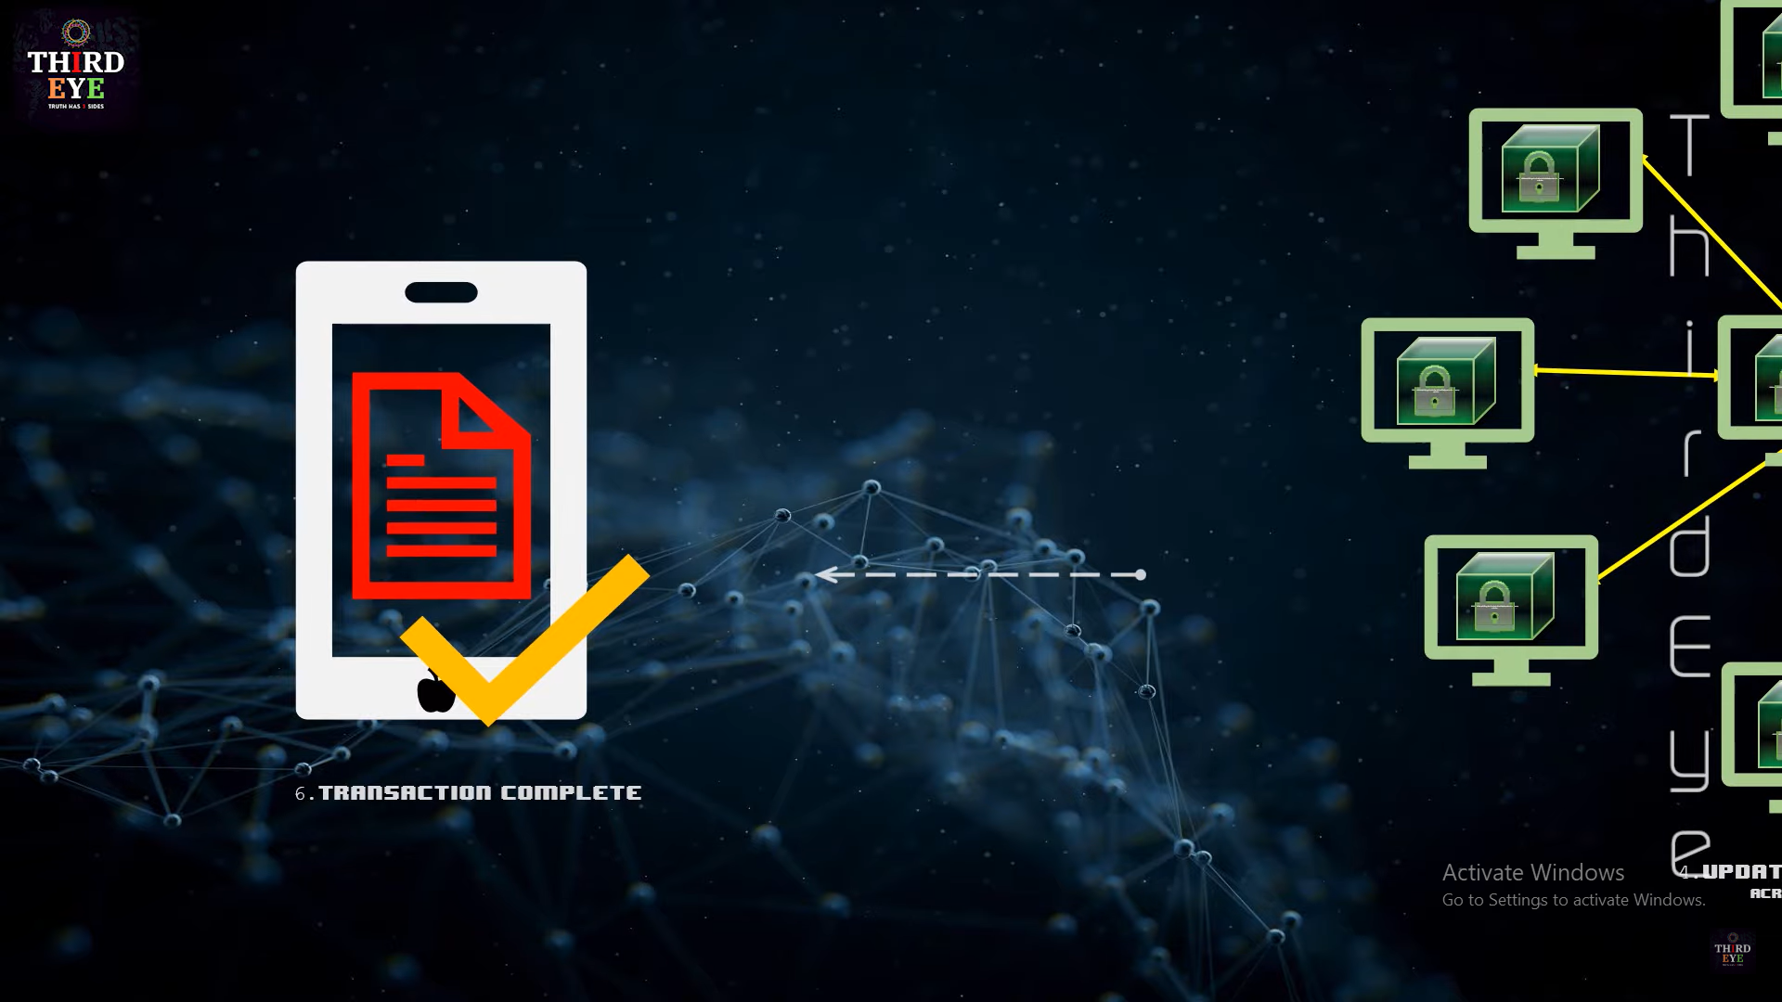
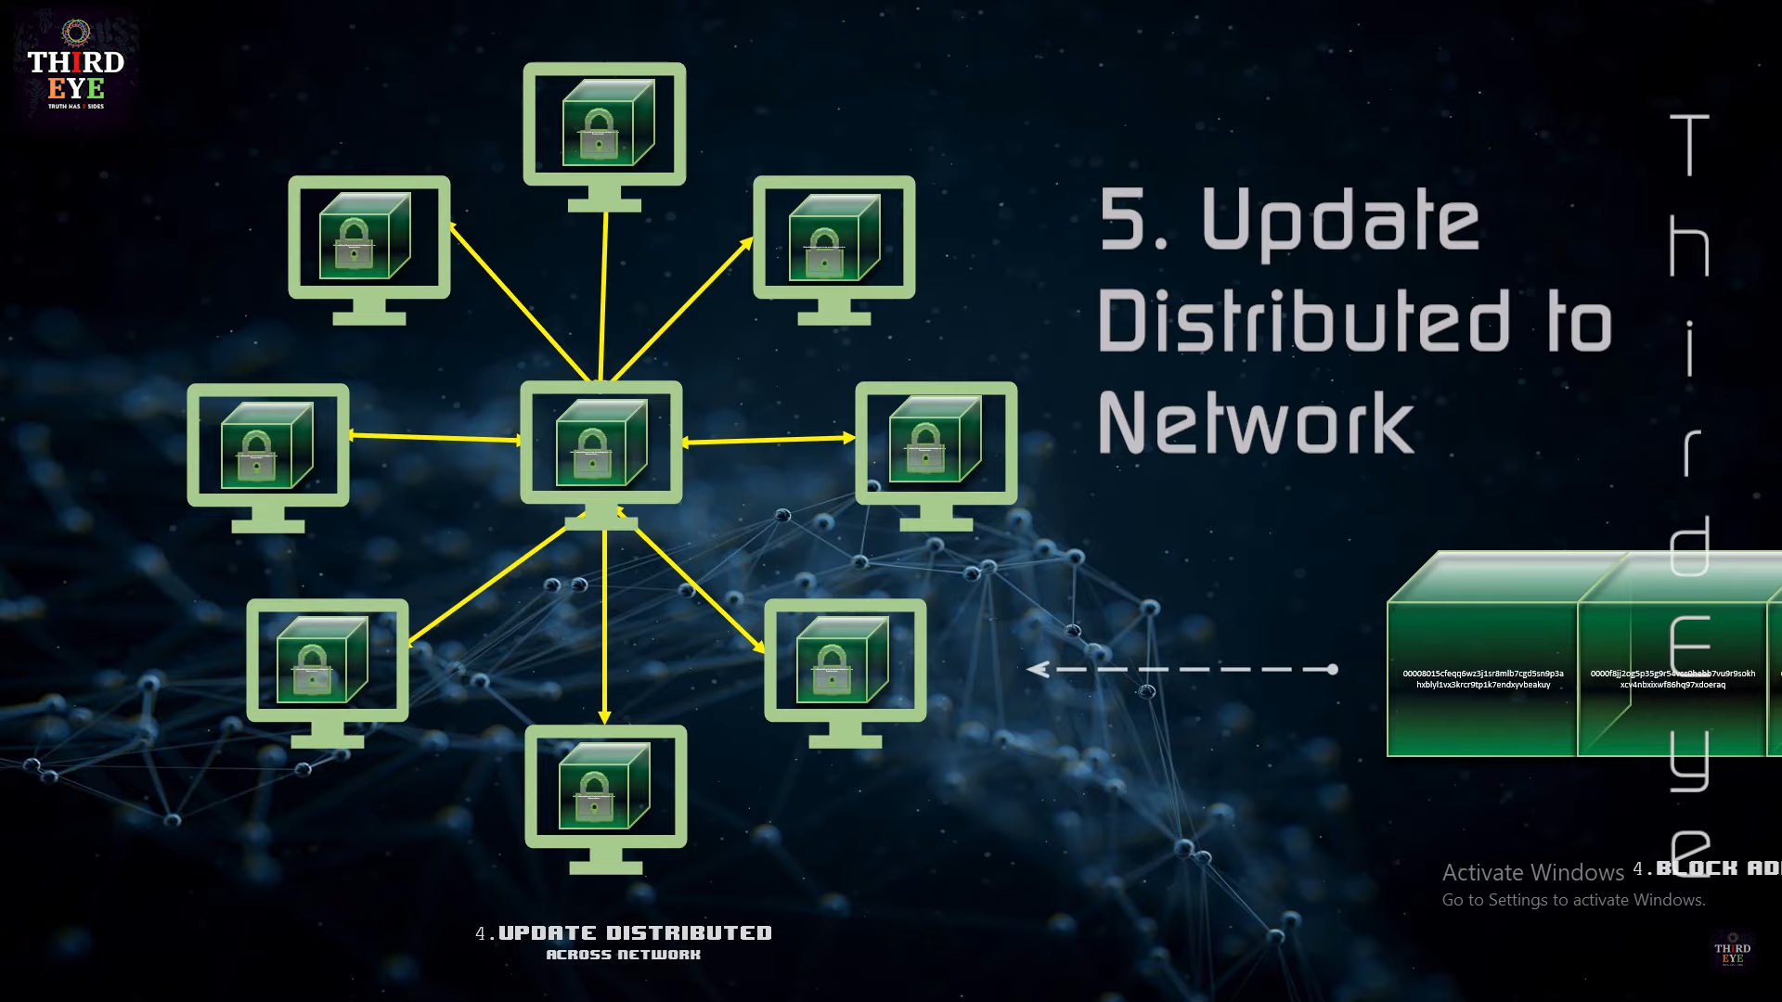
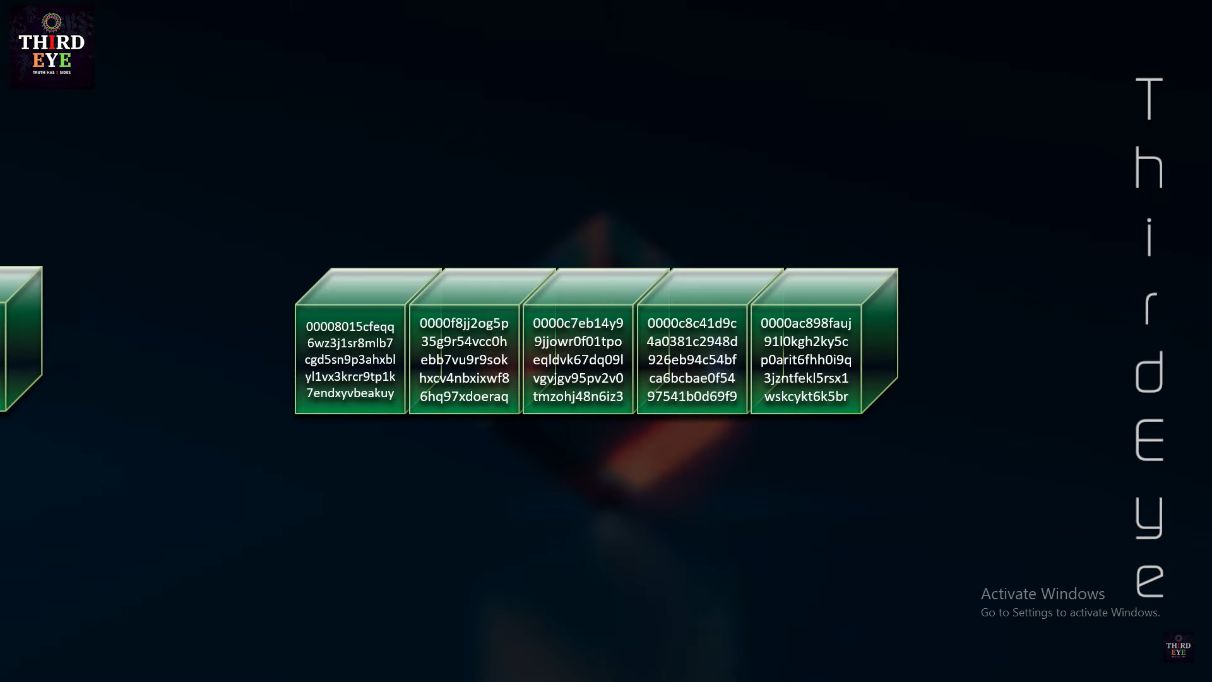
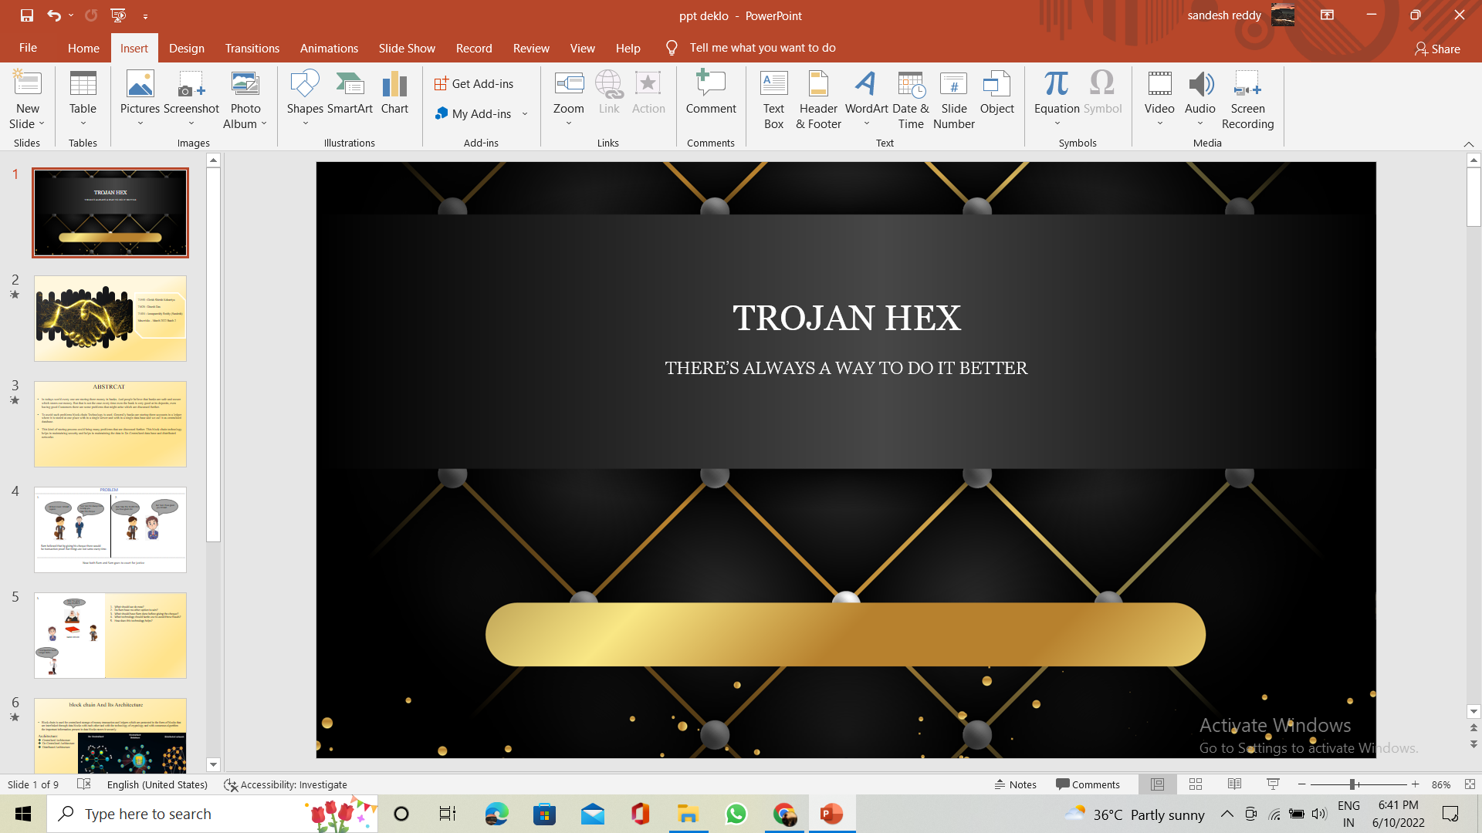
---------------------->
New Transaction
---------------------->
Peer-peer network
Miners approve and
Block added to blockchain
----------------->
----------------------->
----------------------->
Transaction
completed
Update distributed
To network
Architecture For Blockchain

Slide 7
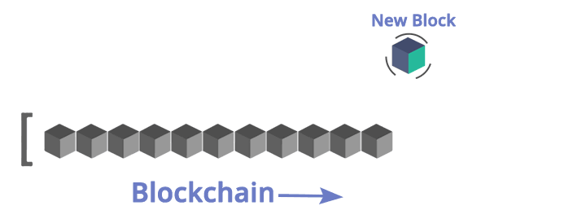

Slide 8
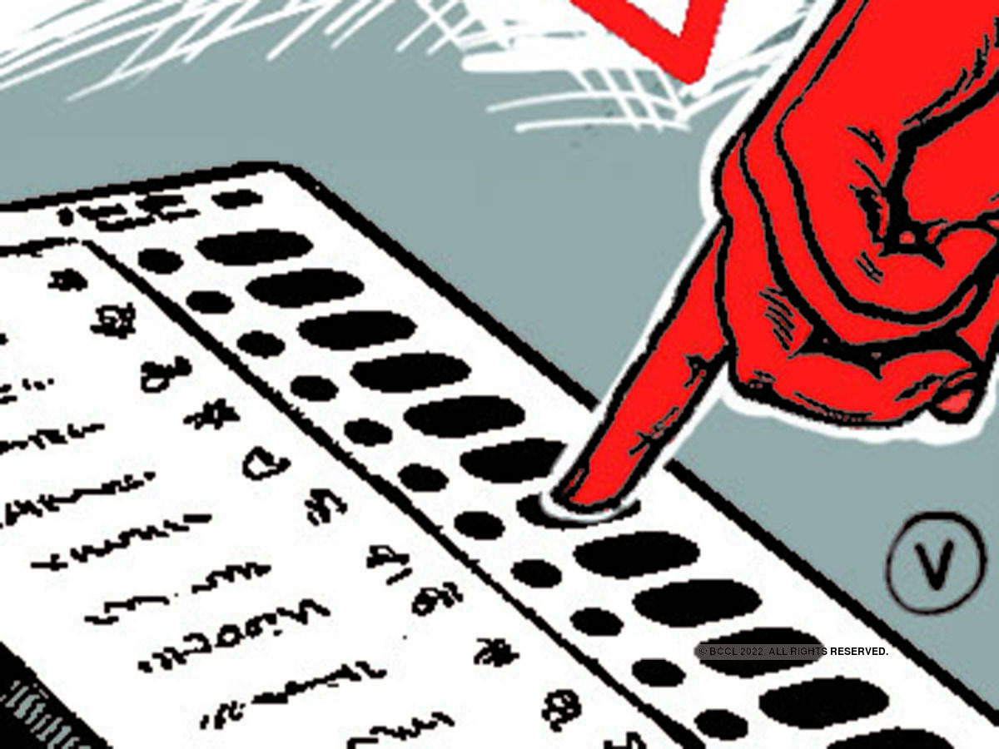



Slide 9
PROTOTYPE

Slide 10
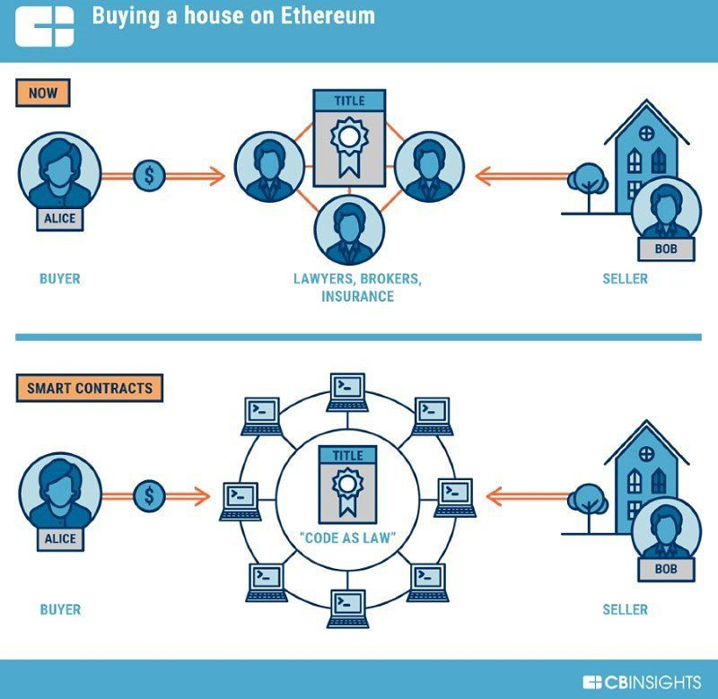

Slide 11
WORKING PROJECT

Slide 12


Slide 13
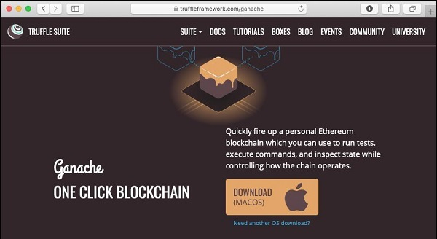

Slide 14
